Slide 1
Moore Machine Based Calculator
Muhammad Maaz Saleem 23FA-013-CS
Muhammad Taha Nadeem 23FA-003-CS

Slide 2
Preventing Misleading Sequential Calculations
Our calculator uses Moore machine to display the automaton’s behavior.
It allows only two digits to be computed then asks for other inputs.
This way user is not fooled by the assumption that BODMAS has been followed.
User gets aware that the first computation took place first.
Some simple calculators evaluate expressions sequentially and keep accepting inputs which makes it seem like BODMAS is being followed.
Lay users often assume BODMAS rules even when the calculator is not following
It.
This leads to misleading results
Our calculator enforces explicit two-operand evaluation

Slide 3
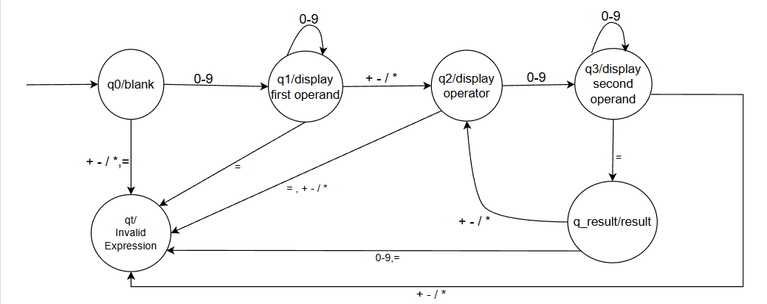
Why Moore Machine?
Output depends only on current state
Finite and deterministic
Best for step-by-step input processing
Machine Components
States represent computation stages
Transitions triggered by input symbols
Output generated from specific state

Slide 4
Demo

Slide 5
Working
State | Meaning | Output
q0 | Start | Ready
q1 | Building first number | Display first operand
q2 | Operator selected | Display Operator
q3 | Building second number | Display second operand
q_result | Computed | Result
qt | Trap | Invalid Expression

Slide 6
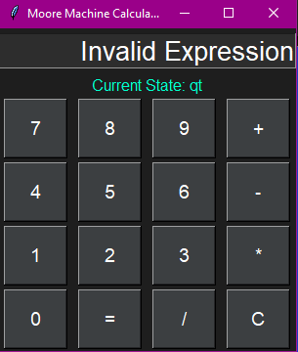
Error State Handling
Different invalid inputs are mapped to trap state. This is to ensure the user can only type
appropriate inputs.
Upon invalid input the state goes to a trap state.
Error State:
Invalid Expression → incomplete or incorrect input
→ BODMAS rule not followed
→ Division By Zero

Slide 7
Thank you
Muhammad Maaz 23FA-013-CS
Taha Nadeem 23FA-003-CS

